Slide 1
Faucet add-on Water Supply Management System using Smart Sensors
Pesented by:
P.Lakshmi kumari (N201010)
M.Kalyani (N200845)
G.Vijaya Joshna(N201089)

Slide 2
Key concepts
INTRODUCTION 7. CIRCUIT DIAGRAM
2. ABSTRACT 8 . OEPERATING MODES
3. OBJECTIVES 9. RESULTS OVERVIEW
4. SYSTEM OVERVIEW 10. GRAPHICAL ANALYSIS
5. DESIGN FLOW 11. ADVANTAGES AND FUTURE SCOPE
6. COMPONENTS 12. CONCLUSION

Slide 3
Introduction
Importance of Water Management:
Only 0.3% of Earth's water is usable.
By 2030, half the population may face water vulnerability.
Need for smart planning and sustainable solutions.
India has more than 18% of the world's population, but has only 4% of world's renewable water resources and 2.4% of world's land area.

Slide 4
Abstract
Summary:
Efficient and cost-effective method to limit daily water usage.
Alerts when water surface excceds its limit while filling the tank.
Embedded algorithm for data acquisition and management.

Slide 5
Objectives
Goals of the System:
Reduce water wastage.
Alert users about excessive usage.
Provide real-time monitoring of water usage.

Slide 6
System Overview
Overview:
Faucet add-on with two modes: Running and Filling.
Integrated sensors and microcontroller for monitoring and alerts.

Slide 7
Design Flow
|
System Workflow:
Data acquisition
Real-time monitoring
Alerts and user interface.

Slide 8
Flow Sensor
Description:
Measures water flow via a Hall-effect sensor(flow sensor)
Outputs digital pulse signals corresponding to flow rate.

Slide 9
Ultrasonic Distance Sensor
Description:
Measures distance using sound waves and echoes.
Calculates water level in containers during Filling mode.

Slide 10
ATmega328 Microcontroller
Features:
8-bit microcontroller with RISC architecture.
Handles data acquisition, monitoring, and decision-making.

Slide 11
Arduino Uno
Role:
Microcontroller board for interfacing sensors and user input/output.
Offers digital and analog pins for versatile applications.

Slide 12
Additional Components
Components:
LCD for displaying information.
LEDs for alerts.
Switches for user interface.
HW battery for power supply.

Slide 13
Operating Modes
Modes of Operation:
Running Mode
Filling Mode

Slide 14
Running Mode Workflow
Process:
Automatic on and off water flow using ir sensor and relay module.
Flow sensor tracks dispensed water.

Slide 15
Filling Mode Workflow
Process:
Ultrasonic sensor measures distance to water surface.
Alerts user when water level nears brim.
Calculates overflow volume if any.

Slide 16
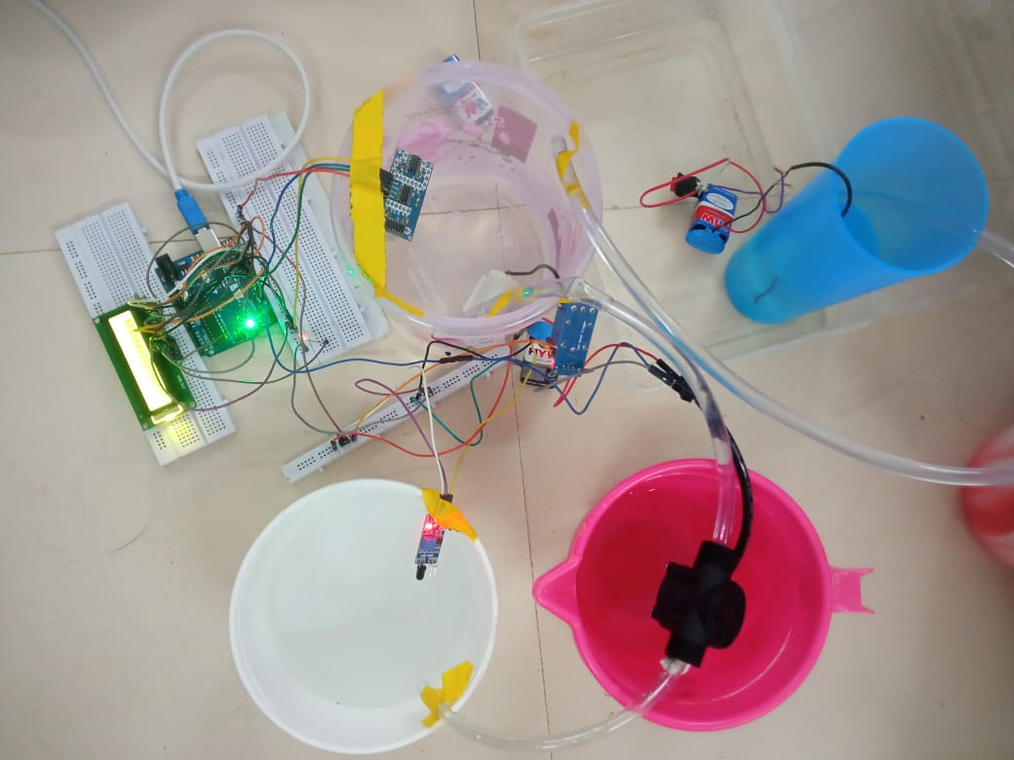
Overview of our project

Slide 17
Results Overview
Key Findings:
Significant reduction in water wastage (~60%).
Data collected for analysis and improvement.

Slide 18
Graph Analysis
Explanation:
Weekly and monthly usage trends.
Running and Filling modes contribute to overall savings.

Slide 19
Advantages
Benefits:
Saves water effectively.
Inexpensive and easy to implement.
Can detect and alert leaks.

Slide 20
Future Scope
Improvements:
Add GSM module for mobile alerts.
Dedicated modes for specific activities.
Use in industrial applications.

Slide 21
Conclusion
Summary:
Efficient solution for water crises.
Promotes sustainable water usage.
Scalable for global impact.

Slide 22
Thank you

